Slide 1

Team Member: - Team Name : - Decoder
1. Shyam Pandav
2. Sarvesh Pathak
3.Chandrakant Koli
4. Pratik Patil
5. Pavan Patil
6. Ajinkya Hatkar
7. Gaurav Medhane

Slide 2
Problems In “Wari”
Traffic Management
Crowd Management
Waste Management
Noise Control
Tap water management

Slide 3
Domain Selection Reason
“ Fair on Kartik Purnima” These events are attended by millions of devotees
Millions are people stay here for Sant Dnyaneshwar
So the Whole alandi get full by peoples for 5 TO 10 days Because of that more Waste is generated in the forms of Bottles, wrapper, plastics bags
and they throw anywhere near the Temple when we avoid this, automatically decrease the problems that are happened by the Waste e.g Diseases , Air pollution, water pollution on Ghat

Slide 4
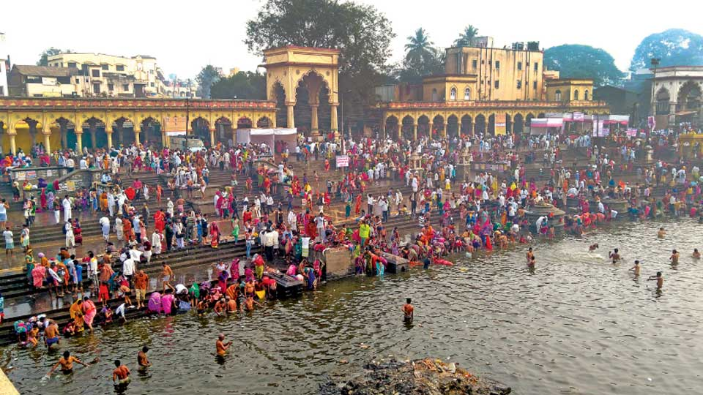
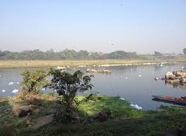
Some Photos of Wari

Slide 5
Problem Statement Selection Process
Stakeholders:
Warkaris
Muncipal corporation
Garbaje Collectors
Vehicle Driver that collects garbaje
Villlagers other than warkaris
Temple trust
Temple workers
Dustbin Manufacturer
Sellers

Slide 6
AEIOU Sheets
AEIOU stands for 5 elements to be coded: Activity, Environment, Interaction, Object, and User.
Activities are goal-directed sets of actions—paths towards things people want to accomplish. What are the modes people work in, and the specific activities and processes they go through?
Environments include the entire arena where activities take place. What is the character and function of the space overall, of each individual's spaces, and of shared spaces?
Interactions are between a person and someone or something else; they are the building blocks of activities. What is the nature of routine and special interactions between people, between people and objects in their environment, and across distances?
Objects are building blocks of the environment, key elements sometimes put to complex or unintended uses (thus changing their function, meaning and context). What are the objects and devices people have in their environments and how do they relate to their activities?
Users are the people whose behaviors, preferences, and needs are being observed. Who is there? What are their roles and relationships? What are their values and prejudices?

Slide 7
Field Visit
On 19th February we visited the Alandi ghat for the analysis of the types of the waste in the area which is aslo similar to that during the Vaari.
In the visit we found out the waste is mainly wet waste like flowers
Plastic waste is the second in rank after that which affects every aspect of environment.
Metallic waste is not that occuring.

Slide 8
Problem Statement
To develope an AI system that shall effectively segregate the waste at the collection point.

Slide 9
Proposed Solution
The collected waste shall be effectively segregated by the AI robotic system using arms.
The system will identify the waste's category by the image recognition optimized by system.
This is heavy system but a sustainable one
It can identify the waste's in even more and better sub categories.
eg: Plastic,metalic,biodegradable.

Slide 10
Requirements
Hardware Requirements:
1.Camera
2.Rasberry pi
3.Robotic arm
Software Requirements:
1.Tensor flow
2.Matlab
3.Open CV

